Slide 1

Real-Time Facial Recognition System with Motion Detection
Addressing modern security challenges with contactless authentication.

Slide 2

System Overview & Real-Time Problem
System Overview
Facial recognition with motion detection for secure, contactless authentication.
Real-Time Problem
Need for secure, efficient authentication beyond passwords and cards.

Slide 3
Security Risks & Attendance Challenges
Security Risks
Attendance & Access
Passwords vulnerable to phishing and theft
Manual systems are slow and error-prone
Protect personal data and assets
Contactless, reliable attendance tracking needed

Slide 4
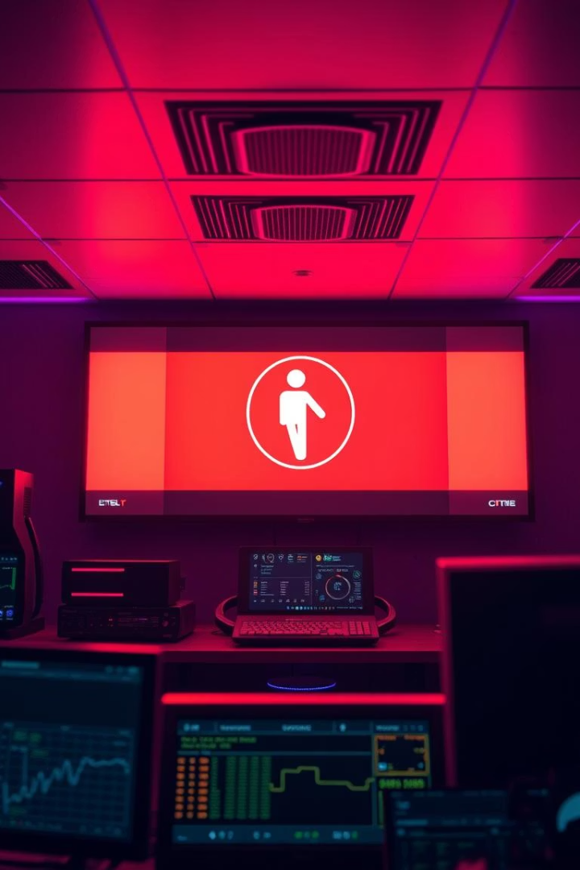
Motion Detection Challenge
Motion detection adds security by flagging unusual activity.
Prevents spoofing, tampering, and unauthorized intrusions effectively.
LINKS;
VIDEO:-https://youtu.be/gJXEuH8qVBQ?si=_ygmW2UxoqhFGCCZ
GITHUB: - https://github.com/nathanyakob19/Face-recognition-.git

Slide 5
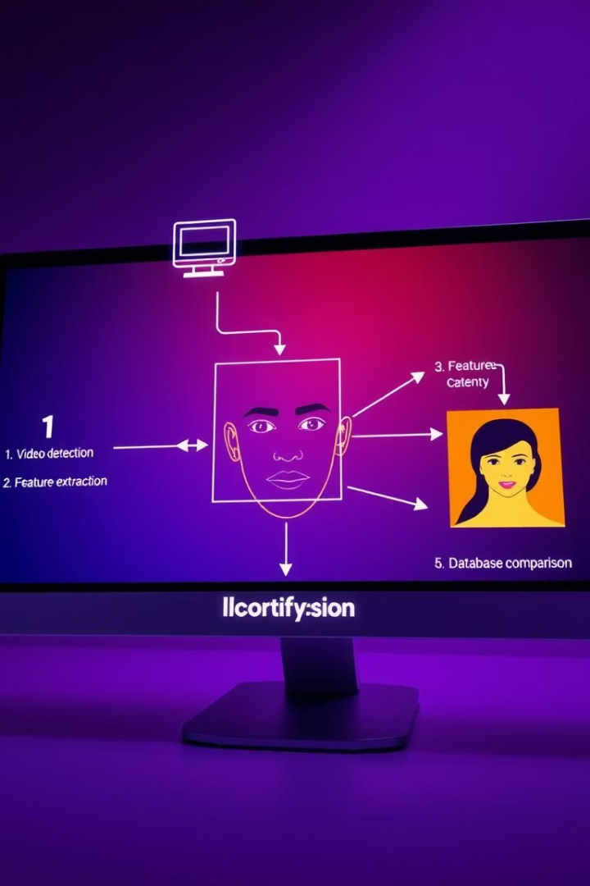




System Architecture & Technology Stack
Python & OpenCV
Core logic, video feed, face detection, motion tracking.
face_recognition Library
128-dimensional face encoding for accurate matching.
MySQL & Flask
Data storage and backend API for user management.
Motion Detection Module
Detects movement to enhance security alerts.

Slide 6
Key Features of the System
Real-Time Facial Recognition
Motion Detection
Fast Processing
Database Integration
Monitors environment and alerts on suspicious movements.
Face matching within 1-2 seconds, minimal latency.
Live webcam feed ensures only registered users access.
Automated user data storage for accurate authentication.

Slide 7

Use Cases & Applications
Employee Attendance
Visitor Management
Automatic, secure tracking without manual input.
Controlled building access with real-time activity monitoring.
Public Safety
Surveillance in public spaces for security alerts.

Slide 8



Testing & Results
Accuracy
Maintains ~92% accuracy despite lighting and occlusions.
Performance
1-2 seconds for encoding, under 0.5 seconds for matching.

Slide 9
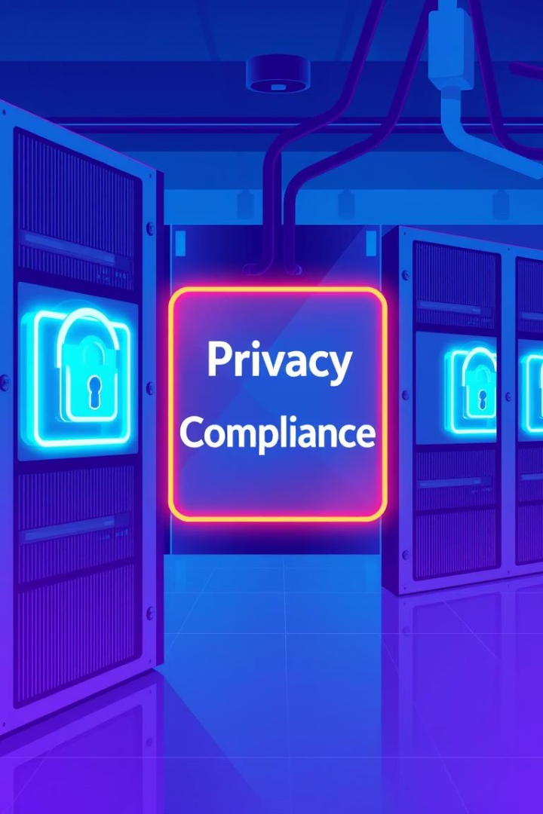




Ethical Considerations & Future Scope
Privacy Compliance
GDPR-compliant data storage with user consent.
Liveness Detection
Prevent spoofing with eye-blink and other checks.
Cloud Integration
Scalable deployment for larger user bases.
Mobile App
Register and authenticate via smartphones.

Slide 10

Conclusion
Combining motion detection with facial recognition solves key security challenges.
Future enhancements will boost reliability and scalability.

